Slide 1


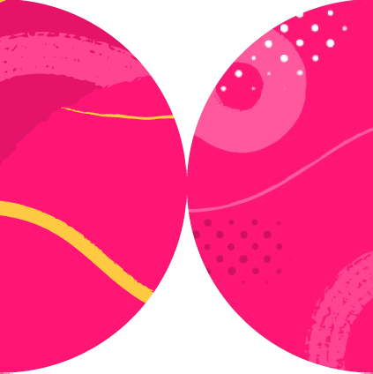

Testing in React 18
Testing Components That Include useEffect

Slide 2
Testable Components
Before
After
Component with effect
Component with effects and other behavior
Pure component with other behavior

Slide 3
useEffect
export default function FilterList({ onChange }) { const [items, setItems] = useState([] as string[]);
useEffect(() => { api.getPlanets().then(setItems);
}, []);
return (
<FilterListPure
…/>
);
};

Slide 4

Hands-On
Filter list with API effect

Slide 5

Summary
Testing components with useEffect

